Slide 1
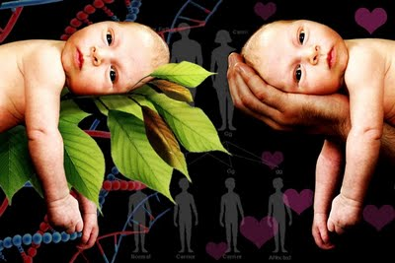
Starter
Nature or Nurture?

Slide 2
Nature: due to inherited characteristics and innate drives
Nurture: due to environmental influences and learning
On your whiteboards, decide whether you think nature or nurture for the following…

Slide 3
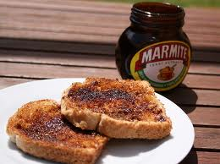
Phoebe loves marmite on toast, just like her dad.
Nature: due to inherited characteristics and innate drives
Nurture: due to environmental influences and learning

Slide 4
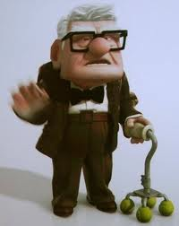
2. Ernest lived to the age of 101
Nature: due to inherited characteristics and innate drives
Nurture: due to environmental influences and learning

Slide 5
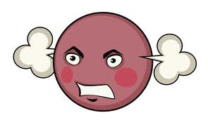
3. Patrick loses his temper easily and often gets into fights.
Nature: due to inherited characteristics and innate drives
Nurture: due to environmental influences and learning

Slide 6
4. John has just come out as being gay.
Nature: due to inherited characteristics and innate drives
Nurture: due to environmental influences and learning

Slide 7
5. Beth has an impressive general knowledge and is a quiz show champion.
Nature: due to inherited characteristics and innate drives
Nurture: due to environmental influences and learning

Slide 8
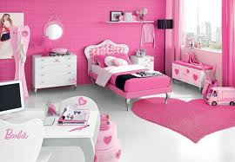
6. Olivia loves the colour pink
Nature: due to inherited characteristics and innate drives
Nurture: due to environmental influences and learning

